Slide 1
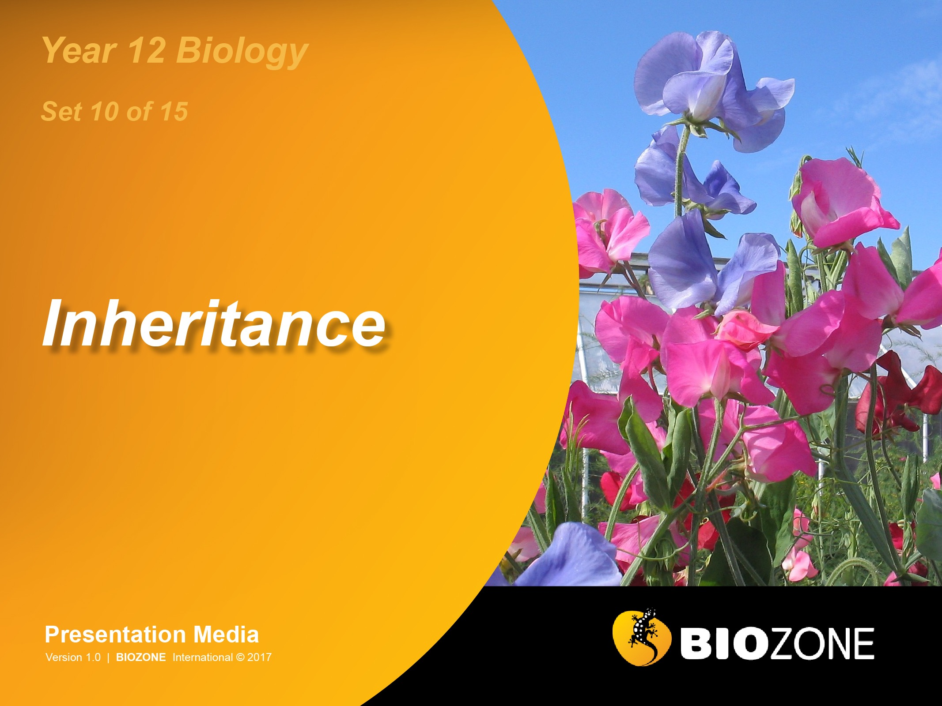

Slide 2

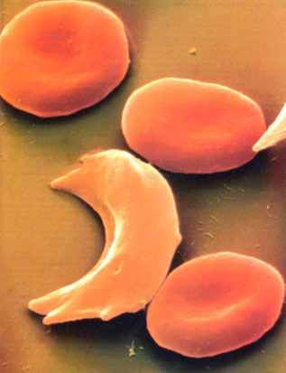
Sickle Cell Anemia
Synonym: Sickle cell disease
Incidence: Most common in people of African ancestry.
West Africans: 1% (10-45% are carriers)
West Indians: 0.5%
Gene type: Autosomal mutation (HBB) on chromosome 11 which results in the substitution of a single nucleotide in the HBB gene coding for the beta chain of haemoglobin.
The allele is codominant.
HBB
Gene location: Chromosome 11
p
q
Normal red blood cells
Sickle-cell
Photo Defiers.com

Slide 3
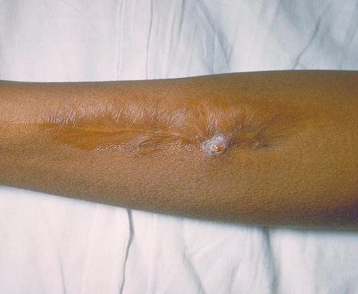
Sickle Cell Disease
Treatment and outlook:
Patients are given folic acid.
Acute episodes may require:
oxygen therapy
intravenous infusions of fluid
antibiotics to treat infection
Experimental therapies include bone marrow transplants and gene therapy.
(Photo CDC)
Sickle cell lesion

Slide 4
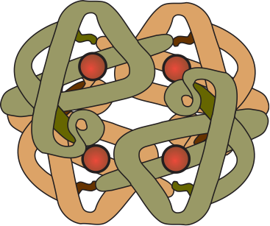
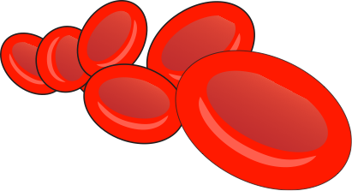

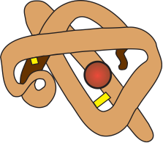

Sickle Cell Mutation
The mutation responsible for causing sickle cell disease is a point substitution.
Hemoglobin molecules
are made up of 2 α-chains and 2 β-chains linked together
Normal red blood cells
containing normal haemoglobin (soluble)
Sickle cells
containing mutant haemoglobin (less soluble)
Beta (β) chain
Alpha (α) chain
Red blood cells normally have a biconcave shape, which enables them to squeeze through capillaries.
When deprived of oxygen, haemoglobin precipitates to form fibres, which deform the red blood cells into a sickle shape.
β-Chain
hemoglobin
First base
Normal base: T
Substituted base: A
The sickle cell mutation involves the substitution of one base for another in the HBB gene, causing a single amino acid to be altered.
DNA
Codes for the 1st amino acid

Slide 5
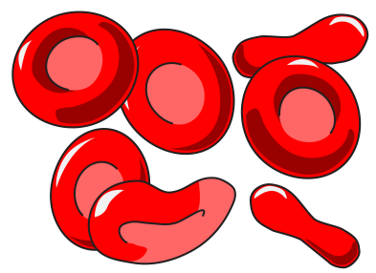


Heterozygote Advantage
Sometimes, individuals that are heterozygous for a gene (Aa) are more common in the population than would be expected.
This is because the heterozygous condition can have higher fitness than either homozygote (AA or aa).
This is termed heterozygote advantage.
Example: Individuals heterozygous for the sickle cell mutation have higher fitness that either homozygous conditions.
The sickle cell mutation produces haemoglobin differing by one amino acid in the beta chain. This causes red blood cells to deform and clump together, causing circulatory and organ function problems.
Hb, Hb
All red blood cells are normal
Hb^{S}, Hb
Mix of normal and sickle red blood cells
Hb^{S}, Hb^{S}
All red blood cells are sickle shaped

Slide 6
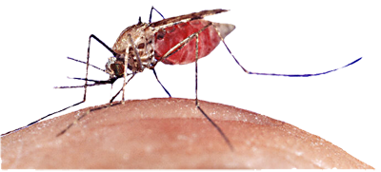
Sickle Cell Gene
The heterozygote advantage of the sickle cell mutation is apparent in regions where malaria is endemic. Why?
Malaria is transmitted by certain species of mosquito which spreads the intracellular protozoan parasite, Plasmodium.
Sickle cells have low potassium levels and the parasites infecting these cells die.
Individuals with a normal phenotype (Hb,Hb) are very susceptible to malaria. Heterozygotes (HbS,Hb) are much less so. Sickle cell homozygotes (HbS, HbS) die from sickle cell disease.
In regions where malaria is prevalent, the HbS allele is present in moderately high frequencies.
This is a balanced lethal system because neither of the homozygotes produces a phenotype with high fitness.
Anopheles mosquito
Normal cells
Sickle
cell
Photo Defiers.com
Sickle cell: note its pale appearance

Slide 7
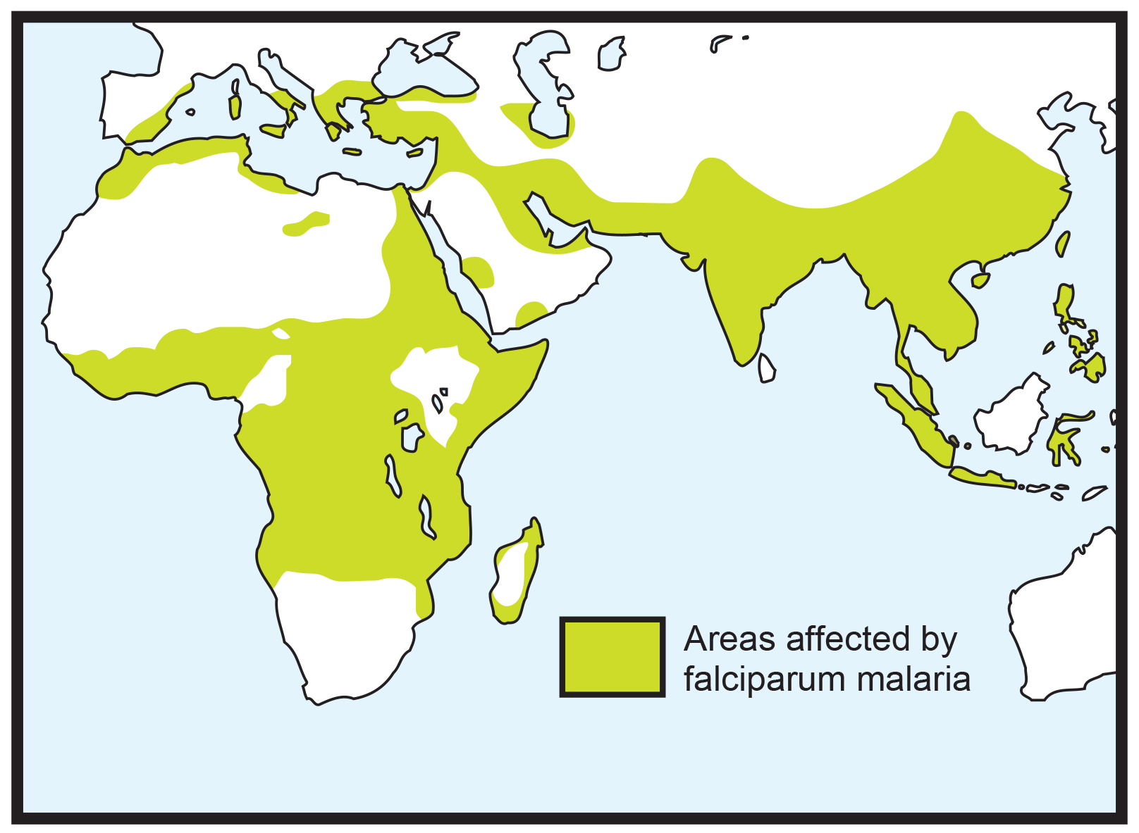
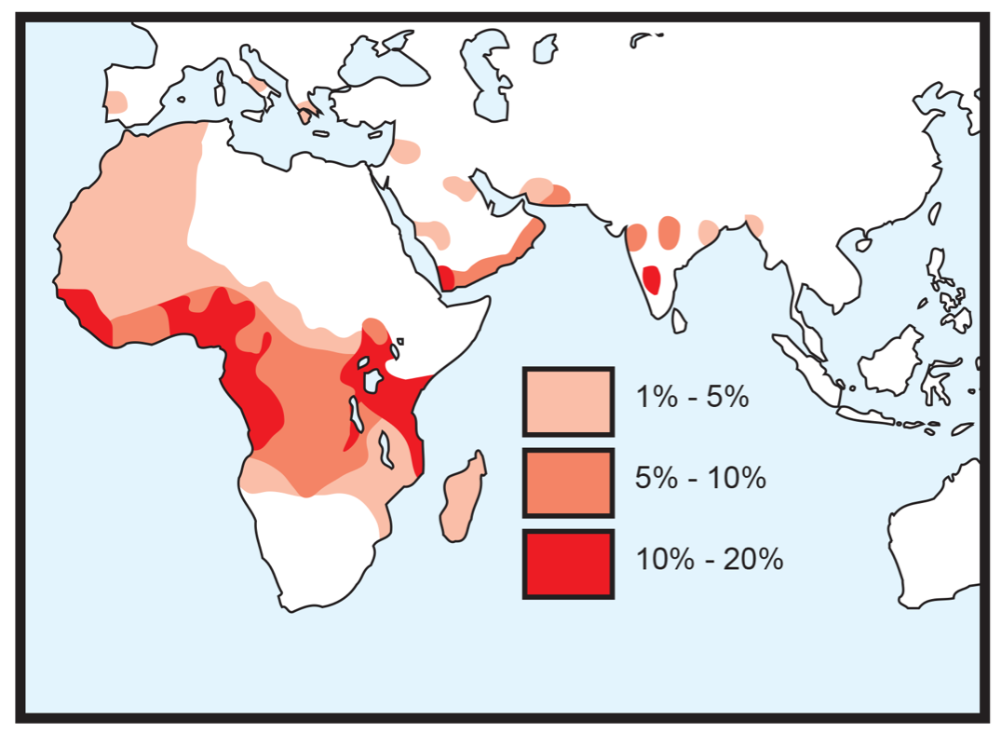
Sickle Cell Disease & Malaria
Frequency of sickle cell allele (Hb^{S})
Incidence of falciparum malaria
Falciparum malaria is a particularly virulent form of malaria caused by Plasmodium falciparum. Falciparum malaria can be fatal within days of the first symptoms appearing.
In large parts of the world, there is a good correlation between the incidence of falciparum malaria and the frequency of the Hb^{S} allele.

Slide 8


Slide 9
Conditions of Use
NOTE: Presentation Media = presentations available on CD-ROM/DVD-ROM or as downloads
BIOZONE retains copyright to the intellectual property included in the Presentation Media files, with acknowledgement that certain photos are used under license and are credited appropriately.
You MAY:
Use the Presentation Media files for presentations in your classrooms using a data projector, interactive whiteboard or overhead projector.
Place the Presentation Media files on any staff computer within the school, including staff laptops, but not in contradiction to clause (g).
Place the Presentation Media files on:
The school’s intranet (school computer network)
VLE (Virtual Learning Environment)
A CMS (Content Management System).
Student and staff access must be restricted to those who are enrolled/working on the campus of the registered purchaser. Student and staff access to a VLE or a CMS must be controlled by a user login and password protocol, but not in contradiction to clause (f). If students have access, they need to be made aware of the Conditions of Use and are only allowed to view the content.
Edit and customise the Presentation Media files by adding, deleting, and modifying information to better suit your needs, but not in contradiction to clauses 2 (c) - (d).
Print out the Presentation Media files in PowerPoint® or Keynote® “Handouts” mode for the express purpose of allowing students to make their own notes about the presentation, but not in contradiction to clause (e).
You MAY NOT:
Place the Presentation Media files on to the Internet or on a service that may be accessed off-campus unless access to the service is protected by a user login and password protocol, and is restricted to students and staff enrolled/working on the campus of the registered purchaser.
Place the Presentation Media files on student laptop computers.
REMOVE any of the references to BIOZONE, the title slides, copyright notices, photo credits, or Conditions of Use from the Presentation Media files.
Create a NEW document using any of the graphics/images in the Presentation Media files.
Print the Presentation Media files on to paper to make your own worksheets for distribution to students.
Incorporate any part of the Presentation Media files for the production of another commercial product.
Share or give away any content off-campus. This prohibition apples to, but is not limited to, sharing via the Internet or any website, (examples: YouTube, slide sharing websites).
Conditions of Use are subject to change without notice. Visit http://www.biozone.com.au/faqconditionsofuse/

Slide 10
Photo Credits
Photographic images are used under license from the following commercial photo libraries:
Corel Corporation Professional Photos (uncoded)
ArtToday.com (coded AT)
Clipart.com (coded CA)
PhotoObjects.com (coded PO)
iStock.com (coded iStock)
Hemera Technologies Inc. (coded Hemera)
Photos.com (coded PC)
Education interactive (coded EII)
Digital Stock (coded DS)
LifeArt (coded LA)
Dollar Photo Club (coded DPC)
Adobestock
3D models were created using Poser
Additional artwork and photographs are the property of BIOZONE International Ltd. All rights reserved.
Some 2D artwork has been adapted from TechPool STUDIOS LifeArt Collections, used under licence.
Images from the Public Domain: Where these licenses have been used, authors and licenses have been acknowledged alongside their image.
Centers for Disease Control (coded CDC)
National Institutes of Health (coded NIH)
National Aeronautics and Space Administration (NASA)
U.S. Department of Agriculture (coded USDA)
Images from the public domain include limited copyright, copyright expired, uncopyrighted, or uncopyrightable material:
Licenses including: GNU Free Documentation License http://www.gnu.org/copyleft/fdl.html
Creative Commons Attribution Share Alike http://creativecommons.org/licenses/by-sa/3.0/
Wikimedia Commons
NOTE: Where images are edited or moved from or within this file, the accompanying photo credit must be retained.

Slide 11
